Slide 1

IBM HR Analytics Employee Attrition &
Performance

Slide 2
Project Outline
This project aims to investigate factors driving employee attrition. We will use a structured approach involving data collection, dataset description, and data cleaning. The project will conclude with a comprehensive analysis of the data and insightful data visualizations.

Slide 3
1.Project Description
HR Attrition Analysis In the business world, companies often face the challenge of retaining talented employees. One of the most pressing issues is the increasing rate of employee turnover, commonly known as HR attrition. Turnover can have a significant impact on a company’s productivity, stability, and long-term sustainability. High attrition rates can lead to increased recruitment and training costs, disrupt team dynamics, and result in the loss of valuable institutional knowledge. Therefore, understanding the factors contributing to attrition and implementing effective retention strategies is crucial for maintaining a competitive edge.

Slide 4
2.Data Collection :
The Data has been collected in the form of a CSV file named "IBM HR.csv"
3.Describing Dataset:
Uncover the factors that lead to employee attrition and explore important questions such as ‘show me a breakdown of distance from home by job role and attrition’ or ‘compare average monthly income by education and attrition’. This is a fictional data set created by IBM data scientists.

Slide 5
4.Data Cleaning:
There were no Null values or blank fields
There were no Duplicates values in the dataset.

Slide 6
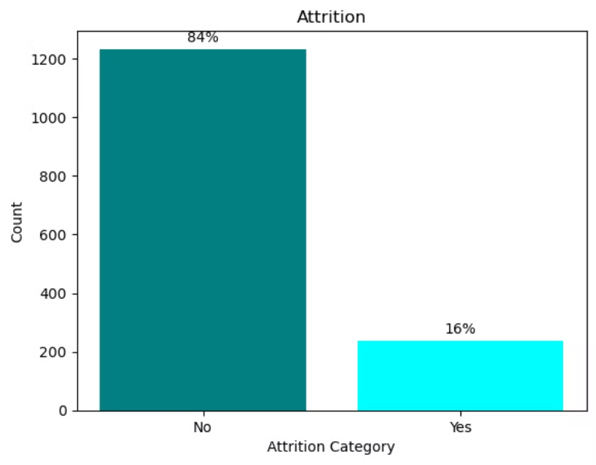
5.Analysis and Visualization:
Attrition Analysis: 16% of employees are leaving the organization, with 84% staying, highlighting potential areas for retention
strategies

Slide 7
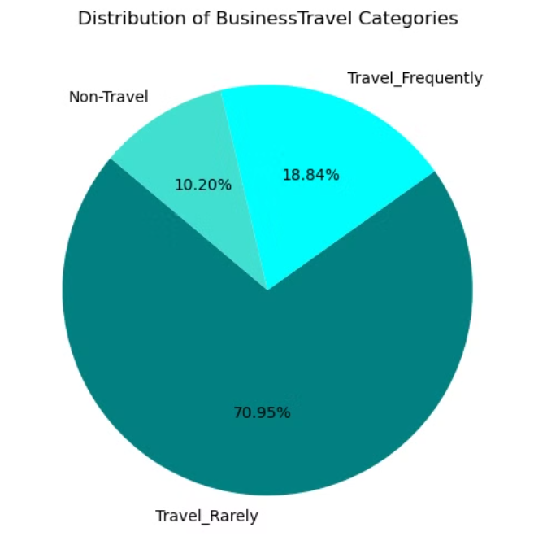
The pie chart shows the distribution of business travel categories. The majority of employees (70.95%) travel rarely, while 18.84% travel frequently and 10.20% do not travel for business.

Slide 8
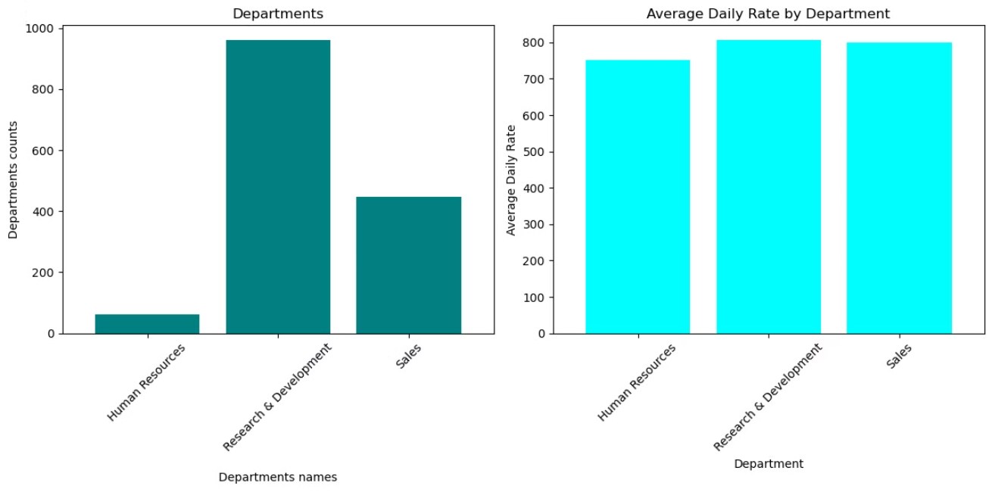
The bar chart shows the number of employees and the average daily rate by department.
The Sales department has the highest number of employees, while the Research & Development department has the highest average daily rate.

Slide 9
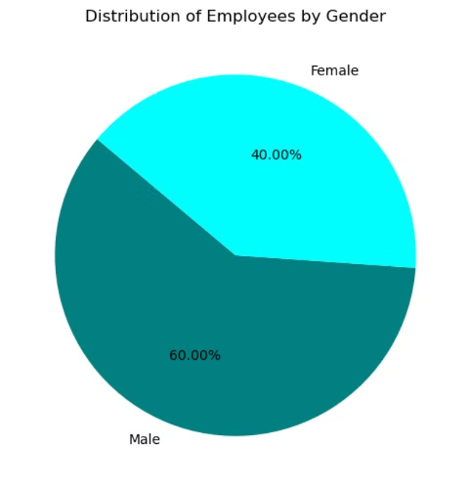
The pie chart shows the distribution of employees by gender. 60% of employees are male, while 40% are female.

Slide 10
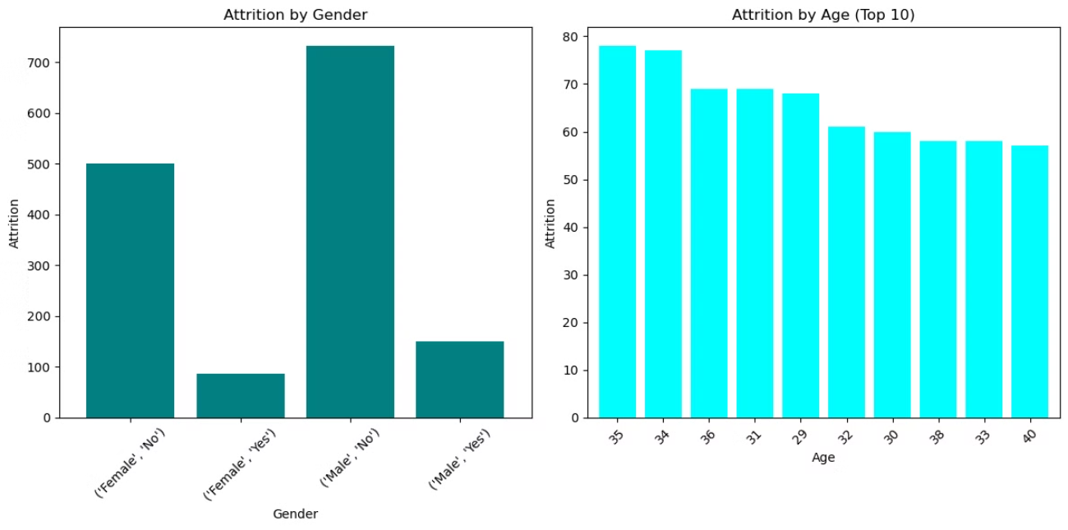
The left chart shows that more male employees have left the company compared to female employees.
The right chart shows that the attrition rate is highest among employees aged 34-36.

Slide 11
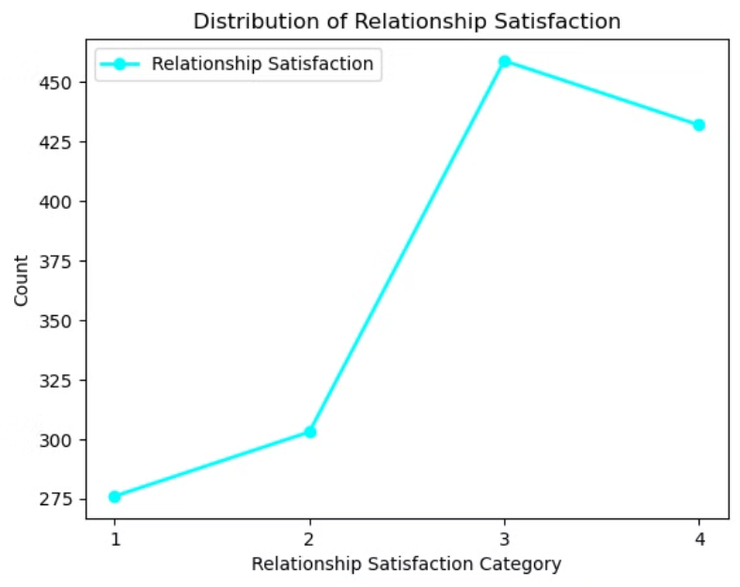
The line chart shows the distribution of relationship satisfaction among employees. The highest number of employees reported a relationship satisfaction rating of 3, followed by 4 and 2. The lowest number of employees reported a relationship satisfaction rating of 1.

Slide 12
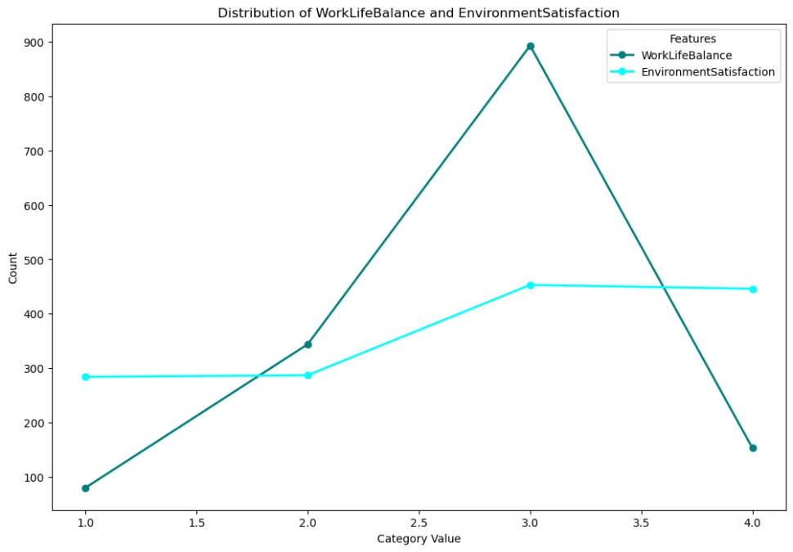
The line chart shows the distribution of work-life balance and environment satisfaction among employees. The highest number of employees reported a work-life balance rating of 3, followed by 4 and 2. The lowest number of employees reported a work-life balance rating of 1. For environment satisfaction, the highest number of employees reported a rating of 3, followed by 2 and 4. The lowest number of employees reported a rating of 1.

Slide 13
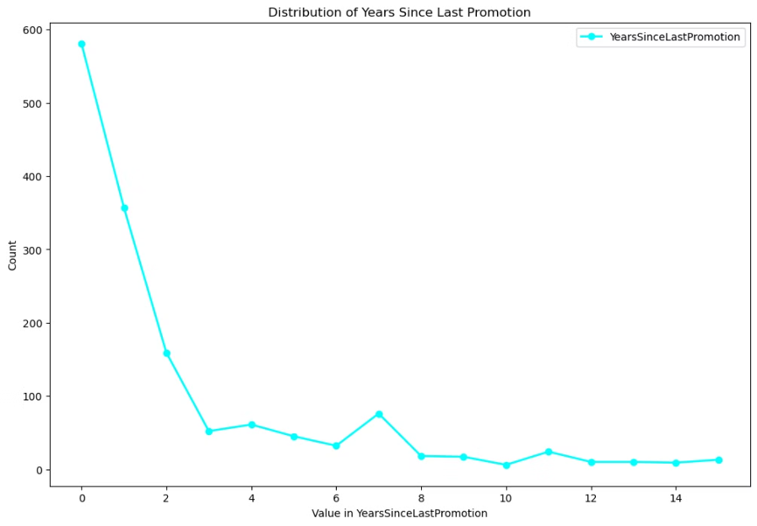
The line chart shows the distribution of years since the last promotion for employees. The highest number of employees were promoted recently (0-2 years), followed by 2-4 years. The number of employees who have not been promoted in a long time decreases as the number of years since the last promotion increases.

Slide 14

Thank you for your time!

